Slide 1
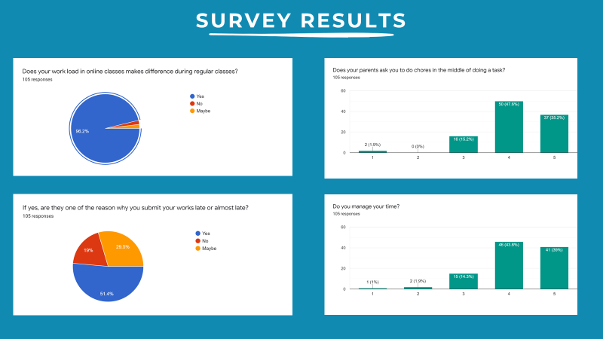
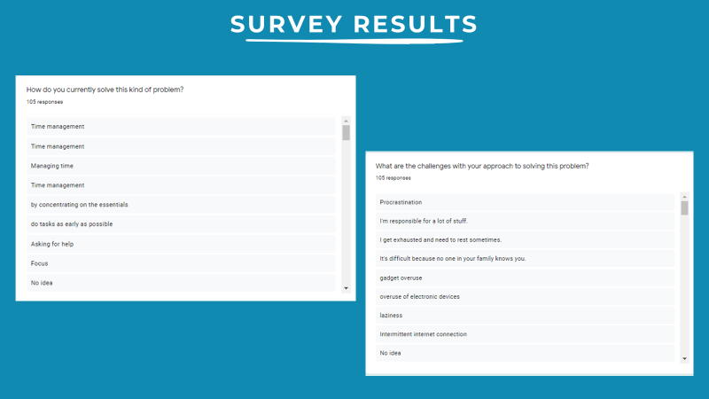
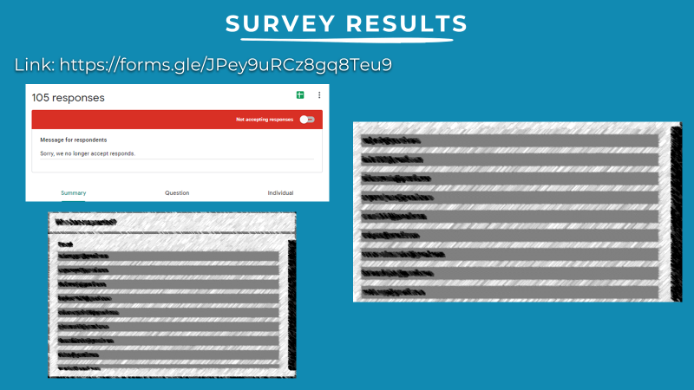
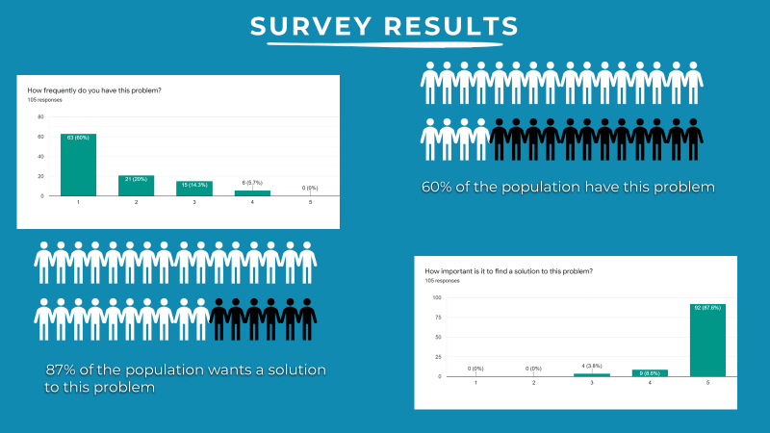




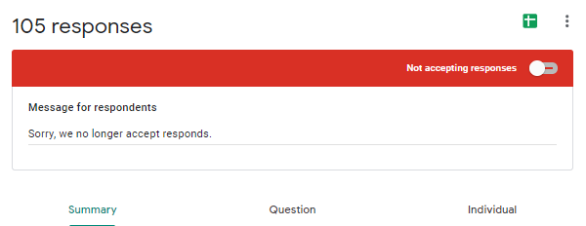


SURVEY RESULTS
Link: https://forms.gle/JPey9uRCz8gq8Teu9
WORK LOADS DURING ONLINE CLASSES
SURVEY RESULTS
ENGBINO, KAYE P.

Slide 2
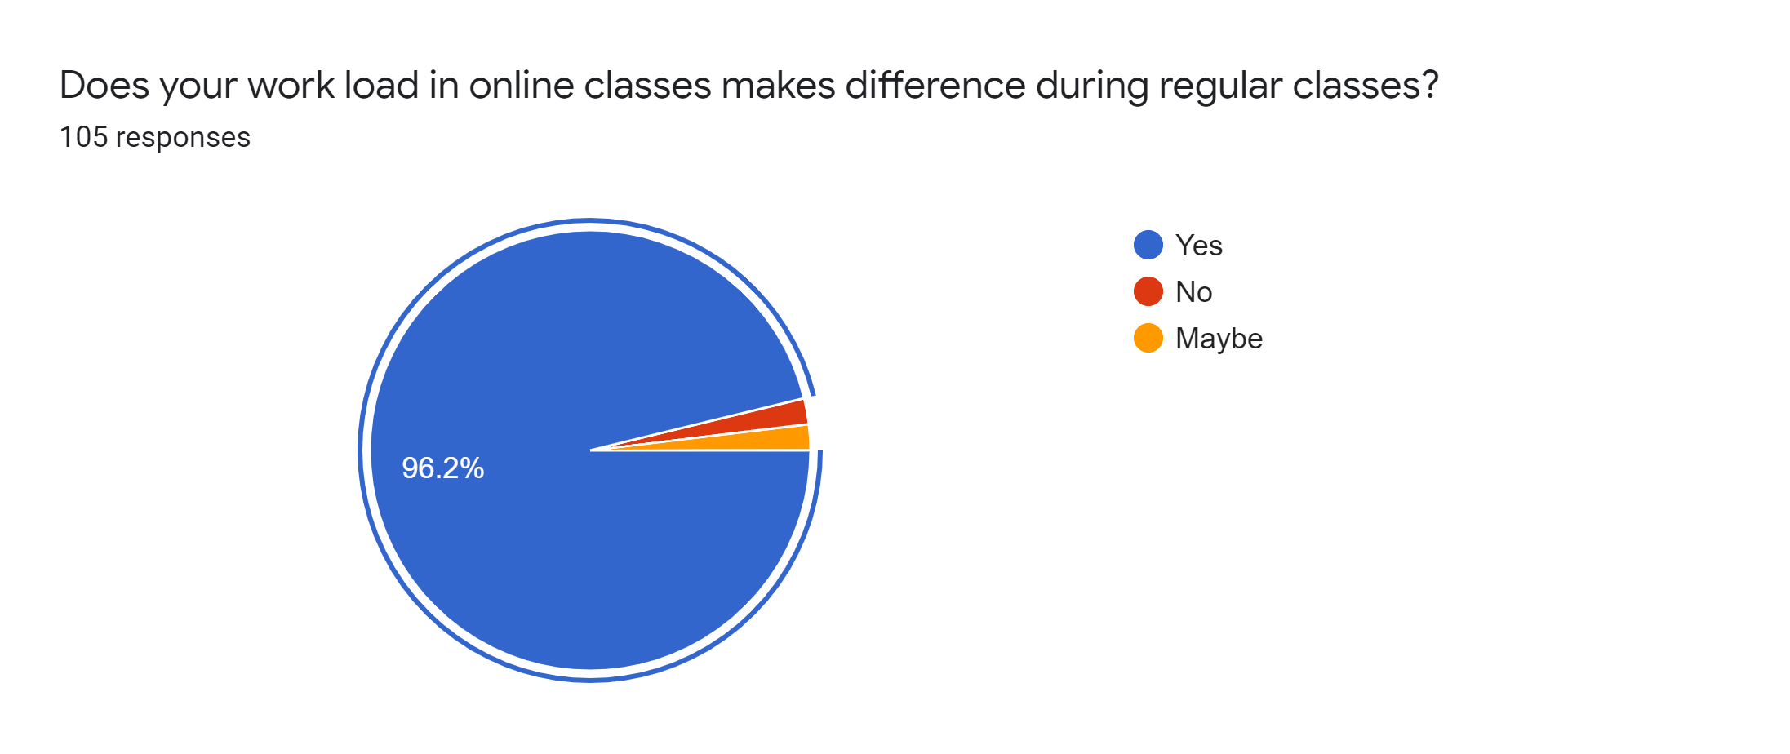
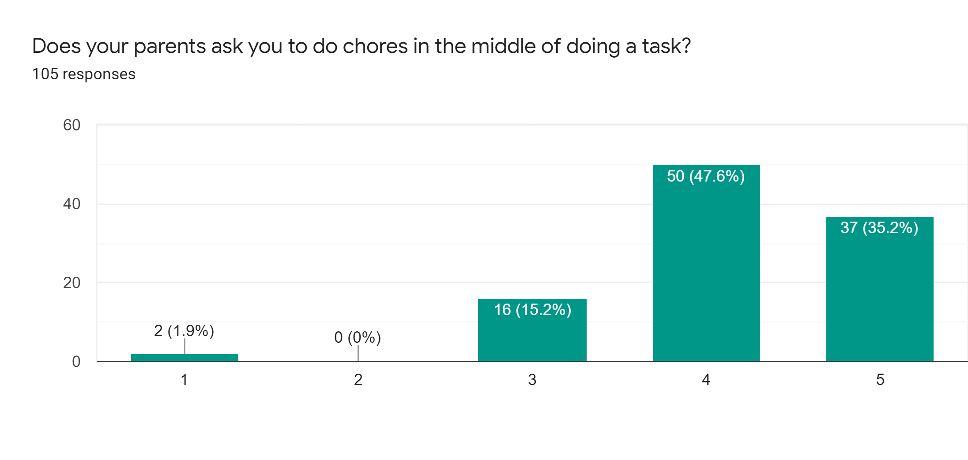

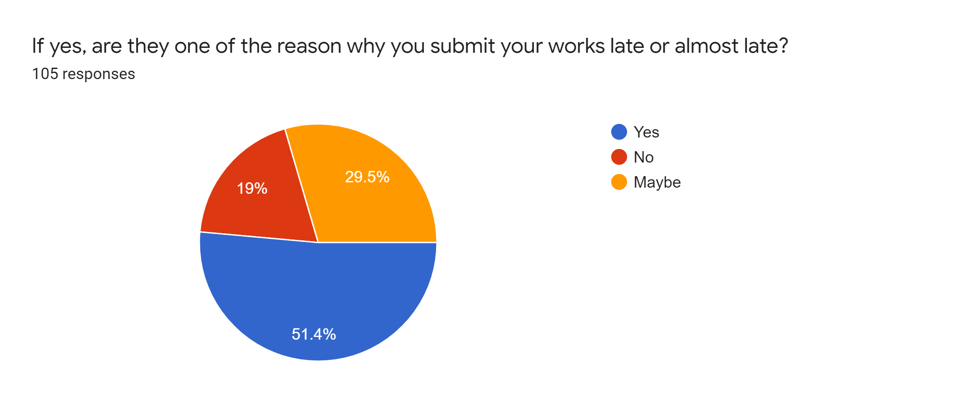
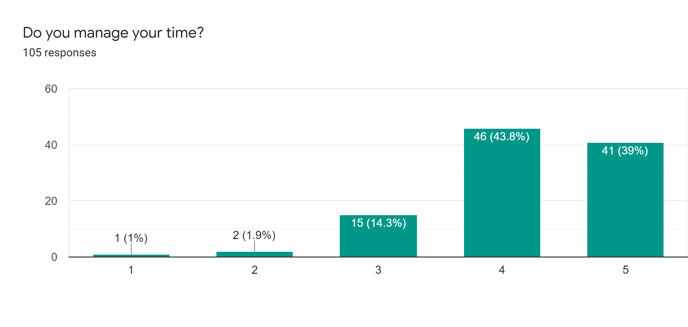
SURVEY RESULTS
SURVEY RESULTS
Link: https://forms.gle/JPey9uRCz8gq8Teu9

Slide 3



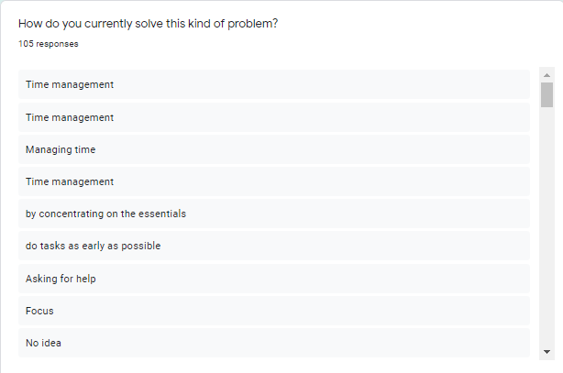
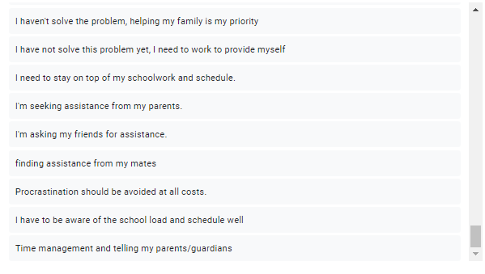
SURVEY RESULTS
SURVEY RESULTS
60% of the population have this problem
87% of the population wants a solution
to this problem

Slide 4
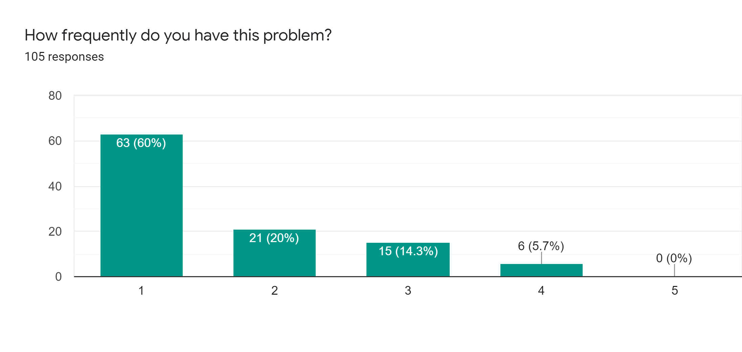
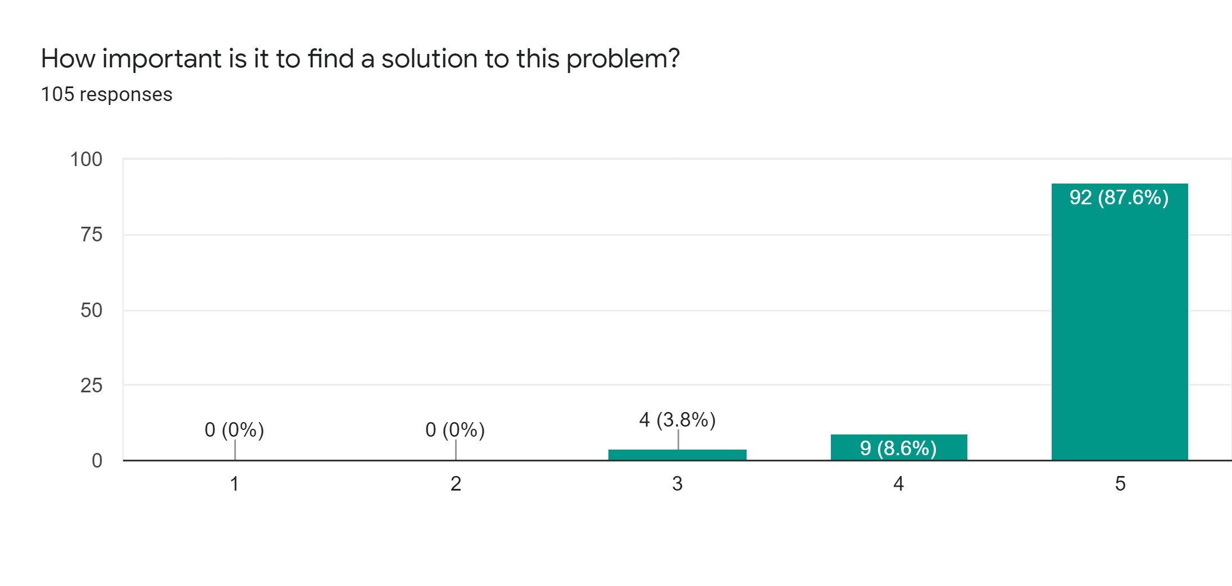
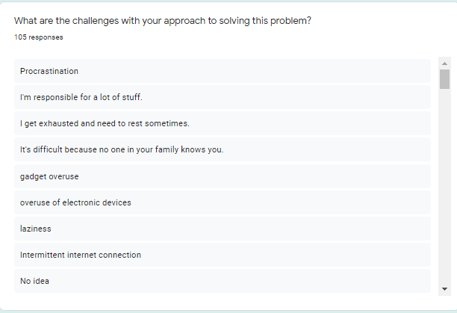
SUBMITTED BY
SURVEY RESULTS
60% of the population have this problem
87% of the population wants a solution
to this problem

Slide 5
SUBMITTED BY
SURVEY RESULTS

